Slide 1

ExamGrader
Intelligent Test Paper Grading System: Reshaping the Future of Education
Presenter: [Your Name]
March 2026
Notes:
大家好，今天我将向大家介绍一款革命性的教育产品——ExamGrader，一个旨在通过AI技术重塑未来教育体验的智能试卷批改系统。我们的目标是解决传统教学中的核心痛点，让教育更智能，让学习更高效。

Slide 2

CONTENTS
01
Executive Summary
Project Vision, Core Value & Market Opportunities
02
行业洞察与核心痛点
教育数字化浪潮与四大核心痛点分析
03
ExamGrader 完整解决方案
四大核心功能模块详解
04
技术架构与核心优势
系统架构与领先技术亮点
05
项目效果与用户反馈
量化数据对比与真实用户评价
06
未来展望与发展规划
短期、中期及长期发展蓝图
Notes:
本次汇报将分为六个部分。首先，我将通过执行摘要快速介绍项目的核心价值。接着，深入分析行业痛点。然后，详细阐述我们的完整解决方案和技术架构。之后，展示项目的实际效果和用户反馈。最后，展望未来的发展规划。

Slide 3
01 执行摘要：项目愿景与核心价值
PROJECT VISION · 项目愿景
通过前沿的 AI 与 RAG 技术，构建一个从“精准批改”到“个性学习”的完整教育闭环，致力于解决传统教学中效率低下、反馈缺失、个性化不足的核心痛点，最终实现“让教育更智能，让学习更高效”的目标。
为教师减负增效
为学生赋能成长
数据驱动决策
将教师从繁重的重复性批改工作中解放出来，使其能专注于教学设计与对学生的个性化辅导，提升教学质量。
提供精准的作业错误诊断、个性化的学习路径推荐和科学的复习规划，让每位学生都能实现高效、自主的学习。
通过对海量学生学习数据的深度挖掘与分析，为学校的教学质量改进、区域教育资源优化及教育政策制定提供科学的数据支撑。
Notes:
首先是执行摘要。我们的愿景是利用AI和RAG技术，打造一个完整的教育闭环。我们的核心价值在于为教师减负，为学生赋能，并通过数据驱动来优化教学决策。这不仅是一个工具，更是一个教育生态的重塑者。

Slide 4
01 执行摘要：市场机遇与核心亮点
万亿级赛道
政策东风
项目核心亮点
8910 亿元
据艾瑞咨询预测，2028年中国AI+教育市场规模
⚡ 技术壁垒：基于OPEA原生集成与RAG技术，实现行业领先的“步骤级”精准错误归因分析。
国家已将“教育数字化”确立为建设“教育强国”的核心突破口。 相关配套政策持续落地，为AI教育技术的规模化应用与商业化变现提供了强有力的顶层支持与市场保障。
📈 效果实证：批改效率提升60%，学生错题再错率降低51%，综合学习效率提升40%。
37%CAGR
2025-2028年复合年增长率 行业正处于爆发式增长期
🔄 闭环生态：打造“智能批改→深度分析→个性化学习→动态复习”一站式解决方案。
Notes:
我们正处在一个巨大的市场机遇中。AI+教育市场规模预计在2028年接近万亿，且保持着37%的爆发式复合增长率。同时，国家将教育数字化作为建设教育强国的核心突破口，政策红利持续释放。
在此背景下，我们的项目凭借三大核心优势脱颖而出：
第一，技术壁垒深厚。我们基于OPEA原生集成与RAG技术，实现了行业领先的“步骤级”错误分析，这是目前很多竞品无法做到的。
第二，效果实证显著。真实数据表明，我们的产品能帮助老师将批改效率提升60%，同时让学生的错题再错率降低一半以上，极大地提升了学习效率。
第三，商业闭环完整。我们不只做单一的工具，而是构建了从“批改-分析-学习-复习”的全链路解决方案，能更好地留住用户并实现商业变现。
这是一个技术、市场、政策三浪叠加的绝佳机会，我们已做好准备，蓄势待发。

Slide 5
02 Industry Insights: The Wave of Digital Education Transformation
The education industry is undergoing a profound AI-driven transformation. From "tool application" to "value inclusion", technology is reshaping the underlying logic of education. Traditional one-size-fits-all teaching models can no longer meet the diverse needs of students in the new era. The market urgently needs intelligent solutions that break through temporal and spatial constraints and truly achieve personalized teaching.
AI is Breaking the "Impossible Triangle" in Education
Mass Coverage
Breaking physical space limits, AI serves tens of thousands of students simultaneously, making quality resources accessible.
High-Quality Standards
Based on massive data & expert experience, delivering standardized, quantifiable high-quality content & feedback.
Personalized Growth
Building precise learning profiles, dynamically generating customized optimal paths for each student.
Notes:
接下来我们看行业洞察。当前，教育数字化转型已是大势所趋。AI技术的发展，正让过去难以兼顾的大规模、高质量和个性化教学成为可能，这为我们的产品提供了广阔的舞台。

Slide 6
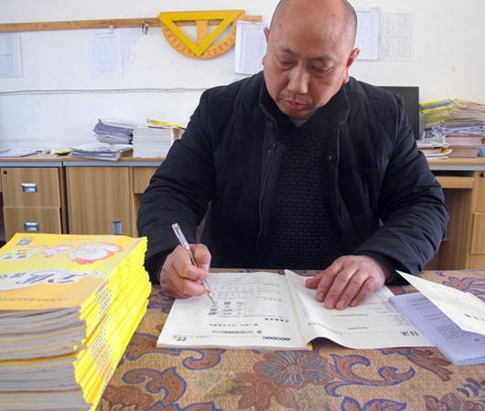
02Core Pain Points
Overburdened Educators, Missing Feedback
The Dual Loss of Efficiency and Depth · Current Situation
• Manual grading is time-consuming: It takes an average of2+ hoursto grade a class's papers, crowding out lesson preparation and rest time.
• Single evaluation dimension: Only focusing on final answers, it is difficult to cover in-depth analysis of problem-solving ideas and processes.
The Dilemma for Both Teachers and Students · Consequences
• Teachers: Trapped in repetitive work, lack of energy, making it difficult to achieve personalized tutoring for each student.
• Students: Only knowing the answer is wrong but unable to learn the "cause", leading to repeated similar problems and low learning efficiency.
Notes:
具体来看行业的痛点。首先是教师负担沉重。传统的人工批改耗时耗力，平均批改一个班的试卷就要超过2小时。这不仅让老师疲惫不堪，更严重的是，缺乏深度反馈，学生无法真正理解错误原因。

Slide 7
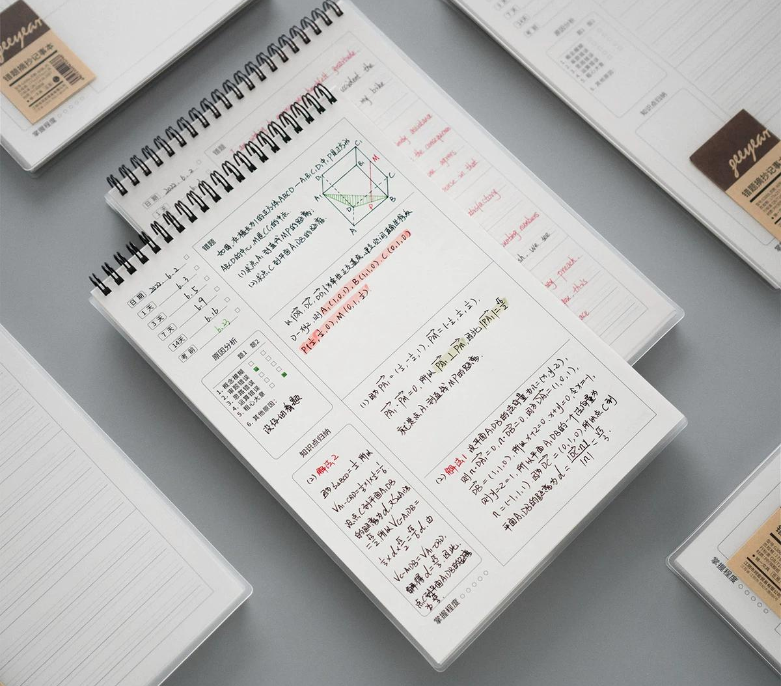
02 Core Pain Points: Chaotic Error Management, Frequent Repetitions
Situation: Inefficient & Fragmented Organization
• Students rely heavily on manual copying for error collection, which is tedious and unsustainable, lacking systematicity.
• Traditional notebooks are mere piles of questions, failing to link with knowledge points for structured review.
Consequence: Gaps in Knowledge, Repeating Mistakes
Without a structured knowledge network, students repeat mistakes on the same points. Statistics show the re-error rate is as high as45%, severely reducing efficiency.
Notes:
第二个痛点是学生的错题管理混乱。手动抄错题不仅效率低下，而且不成体系，导致学生反复在同一个地方跌倒。数据显示，传统学习方式下，错题再错率高达45%，这是一个惊人的数字。

Slide 8

02 Core Pain Points:
Aimless Review, Unmet Personalization Needs
Aimless Exam Preparation
Faced with overwhelming materials, students lack clear direction and review without focus, wasting time on mastered knowledge.
Homogenized Learning Resources
Standardized resources fail to adapt to unique learning paces, making it hard to assess individual progress.
Notes:
最后，复习的盲目性和学习资源的同质化也是两大痛点。学生不知道自己的薄弱点在哪里，复习时抓不住重点。同时，统一的教学内容无法满足个性化需求，导致学习效率低下，兴趣不高。这些痛点共同指向了一个方向：我们需要一个更智能的解决方案。

Slide 9

03
The Complete ExamGrader Solution
Building an Intelligent Education Ecosystem Covering "Teach-Learn-Practice-Test"
Notes:
针对以上痛点，我们推出了ExamGrader的完整解决方案。它不仅仅是一个批改工具，而是一个覆盖“教、学、练、考”全流程的智能教育生态系统。接下来，我将详细介绍它的四大核心功能模块。

Slide 10
03 Solution: Granular Test Paper Grading
Beyond Right or Wrong · Making Grading More Valuable
Driven by Dual Engines: AI + RAG
Step-by-Step Error Diagnosis
Intelligent Grading Templates
The system leverages LLM for semantic understanding and RAG to retrieve knowledge points, providing in-depth, step-by-step analysis of student responses.
Precisely identifies errors in each step, analyzes causes (e.g., misconceptions, miscalculations), and provides targeted feedback.
Teachers customize grading templates for standardized, efficient batch processing, reducing repetitive manual labor.
Notes:
The first core feature is granular test paper grading. Our system goes beyond simple right/wrong judgments to make every grading meaningful.
This is reflected in three aspects:
First, driven by dual engines (AI + RAG). The system combines LLM's semantic understanding with RAG to link knowledge points and standard solutions for in-depth analysis.
Second, step-by-step error diagnosis. Instead of just marking wrong answers, we analyze each step to pinpoint errors and their causes (logic, concepts, etc.), providing targeted feedback.
Third, intelligent grading templates. To balance personalization and efficiency, the system supports customizable templates for standardized, parallel processing of large-scale grading, effectively reducing teachers' workload.

Slide 11
03 解决方案：智能错题管理
构建个人知识图谱
自动归集与关联
优化方法推荐
错误模式分析
系统自动将批改出的错题收集入库，并通过pgvector 向量技术，将其与相关知识点、相似题目、历年真题进行智能关联，构建网状知识体系。
针对每一道错题，系统不仅提供正确答案，更会基于RAG 检索增强技术推荐多种优化的解题思路、更优解法和避坑技巧，有效帮助学生拓宽解题思维。
基于大数据算法，持续追踪并深度分析学生的答题记录，精准识别易错知识点、高频错误类型和思维盲区，为后续个性化学习路径的规划提供坚实的数据基础。
Notes:
第二个功能是智能错题管理。系统会自动归集错题，并利用向量技术进行智能关联，构建每个学生的个人知识图谱。更重要的是，它会推荐多种优化的解题方法，并分析错误模式，为个性化学习打下基础。

Slide 12

03 解决方案：个性化学习资料推荐
为每个学生定制学习路径
动态知识掌握度追踪
系统通过分析学生的作业、测验数据，实时更新其知识点掌握度图谱，精准定位学习盲区。
RAG 赋能的智能推荐
基于学生的薄弱知识点，从题库、讲解视频、文档等多种资料库中，检索并推荐最匹配的学习资源。
反馈闭环与成效
利用学生评分持续优化算法，形成良性循环。经实测，该系统能将学生的自主学习参与度显著提升18-25%。
Notes:
第三个功能是个性化学习资料推荐。系统会动态追踪学生的知识掌握度，并利用RAG技术，从海量资源中为每个学生精准推荐最合适的学习内容。同时，学生的反馈会帮助系统不断优化推荐算法，形成一个越用越智能的闭环。这一功能已被证明能有效提升学生的参与度。

Slide 13
03 Solution: Intelligent Pre-Exam Review Planning
Making Every Minute Count
Big Data Analysis of Exam Questions
Personalized Review Plan Generation
Targeted Practice Tests
The system extractshigh-frequency test points, trend changes and proposition rulesvia AI analysis of past exam questions.
Generatesdaily review priorities and task listsbased on students' mastery and remaining time.
Createspersonalized diagnostic papersto identify blind spots and consolidate weak areas.
The global AI tutoring market is projected to grow explosively by 2026, showing huge potential.
2026 Market Size:$3.16 Billion
Notes:
第四个功能是考前智能复习规划。系统通过分析高考真题大数据，结合学生的个人情况，生成个性化的复习计划。还能一键生成针对性的检查卷，帮助学生高效复习，真正做到让每一分钟都花在刀刃上。

Slide 14
04 Technical Architecture: Modern, Highly Scalable Microservices Architecture
Web Frontend| Core Stack: React + TypeScript
Delivers an extremely smooth interactive experience with responsive layout for consistent UI across devices.
API Service| Core Stack: FastAPI
High-performance async API framework for high concurrency, auto docs, and rapid stable backend development.
Agent Service| Core Stack: OPEA Comps
Central hub for system AI capabilities, integrating multi-modal and orchestration to drive intelligent logic.
Database Cluster
PostgreSQL + pgvector Structured data storage & vector search
LLM Inference
vLLM Inference Engine High concurrency & low latency responses
Embedding Service
High-performance Vectorization Convert unstructured data to vectors
Notes:
接下来看技术架构。我们采用了现代化的微服务架构，从前端到后端，再到AI核心服务，层次清晰。底层采用PostgreSQL加pgvector进行数据存储和向量检索，vLLM提供高效的大模型推理能力，确保了系统的高性能和高可用性。

Slide 15
04 Core Technical Highlights (1/2)
Native OPEA Integration
Vector Database (pgvector)
Leading Step-by-Step Analysis
Built entirely on the Open Enterprise AI (OPEA) platform components, enabling rapid integration and deployment of AI capabilities, reflecting technical foresight and engineering efficiency.
Utilizes thepgvectorextension of PostgreSQL for efficient vector similarity search, the core of intelligent functions like question association.
Combines LLM's deep understanding and RAG's retrieval for industry-leading step-level error diagnosis, surpassing traditional answer comparison.
Notes:
我们的核心技术亮点首先体现在三个方面：第一，我们原生集成了OPEA平台，保证了技术的前瞻性和效率。第二，我们应用了pgvector向量数据库，这是实现智能推荐的关键。第三，我们实现了行业领先的步骤级分析能力，这是我们超越传统批改工具的核心。

Slide 16
04 Core Technical Highlights (2/2)
04
05
06
RAG-Enhanced Intelligent Recommendation
Efficient LLM Inference (vLLM)
Complete Feedback Loop
Through RAG technology, the system dynamically retrieves the latest and most relevant information from the knowledge base, providing students with accurate and interpretable optimization methods and learning materials.
UsingvLLMas the LLM inference service significantly improves the model's response speed and throughput, ensuring a smooth and low-latency user experience.
Established a complete feedback mechanism from user profile scoring to algorithm model iteration, enabling the system to continuously self-evolve and truly become "smarter with use".
Notes:
Additional technical highlights include: Fourth, RAG-enhanced intelligent recommendation for more accurate and interpretable content. Fifth, we use vLLM for efficient LLM inference to ensure a smooth user experience. Finally, we have established a complete feedback loop to enable continuous learning and evolution of the system.

Slide 17
05 Project Results: Quantitative Data Comparison
Grading Time
Error Rate
Review Focus
Efficiency
Satisfaction
Trad: 2h/class
Sys: 0.8h/class
Trad: 45%
Sys: 22%
Trad: Baseline
Sys: Enhanced
Trad: Baseline
Sys: Optimized
Trad: 3.2/5.0
Sys: 4.5/5.0
↓ 60%
↓ 51%
↑ 70%
↑ 40%
↑ 41%
Data source: Internal testing and early user feedback statistics (2025)
Notes:
那么，我们的产品实际效果如何呢？数据是最好的证明。与传统方式相比，我们的系统将批改时间缩短了60%，错题再错率降低了51%，学习效率提升了40%，学生满意度也大幅提高。这些数据充分证明了ExamGrader的价值。

Slide 18

05 User Feedback: Teacher End
"Grading papers used to be the biggest headache; I'd spend my entire weekends on it. With ExamGrader, I can finish in one night now. The system also analyzes each student's issues, making my teaching more targeted."
—— Math Teacher, Grade 12, Key High School
"The learning materials recommended by the system are of high quality, saving me a lot of time in screening. Now I can focus more on lesson preparation and interaction with students."
—— Physics Group Leader, Junior High School
Notes:
除了量化数据，我们还收到了许多来自用户的真实反馈。教师们普遍反映，ExamGrader极大地减轻了他们的负担，让他们能更专注于教学本身。系统的分析和推荐功能也让他们的教学更有针对性。

Slide 19

05 User Feedback: Student End
“No more manual copying of wrong answers! The system organizes them automatically, tells me where I went wrong, and how to correct them. Now I know my weak points, and review is much clearer.”
—— A High School Sophomore
“The review plan generated before exams is very useful. Following the plan makes me feel secure, and I no longer do random practice problems like before.”
—— A High School Senior
Notes:
学生们也对产品给予了高度评价。他们认为自动整理错题、精准的错误分析以及个性化的复习计划，让他们的学习变得更轻松、更高效，不再盲目。这些反馈是我们前进的最大动力。

Slide 20
06 Future Outlook: Development Plan
Short-Term Goals
Next 1-2 Years
Mid-Term Goals
Next 3-5 Years
Long-Term Goals
Next 5+ Years
🎯 Product Refinement Complete core component development; optimize UX.
📚 Subject Expansion Add support for Physics, Chemistry & more.
🧠 Algorithm Upgrade Iterate recommendation models for accuracy.
⚡ Deepen Functions:Support complex Q&A grading.
💬 Enhance Interaction:Launch AI teaching assistant.
📱 Multi-Platform:Release iOS/Android Apps.
🤝 Collaboration:Build teacher sharing community.
🌏 Ecosystem Building Connect students, teachers & institutions.
🌐 Global Strategy Expand multilingual support overseas.
🏆 Ultimate Vision Create an "All-in-One AI Tutor" for education.
Notes:
最后，展望未来。我们为ExamGrader制定了清晰的发展路线图。短期内，我们将完善产品、拓展学科。中期，我们将深化功能、增强互动并覆盖多端。长期来看，我们的目标是构建完整的教育生态，并最终打造出真正的“AI教师助手”。

Slide 21
06 Future Outlook: Building a Complete Intelligent Education Ecosystem
ExamGrader's ultimate goal is to build a complete, adaptive intelligent education ecosystem that deeply connects students, teachers, parents, and educational institutions. We aim to break down information barriers, leverage precise data analysis and algorithmic support to enable personalized learning path planning and tutoring throughout the entire process from teaching to learning to management, and truly empower education with technology.
OUR VISION
Making Education Smarter, Learning More Efficient
CONNECTING STUDENTS, EMPOWERING EDUCATORS, SHAPING THE FUTURE
Notes:
我们的终极目标是构建一个完整的智能教育生态，让每一个参与者都能从中受益。我们坚信，通过技术的力量，我们能够实现“让教育更智能，让学习更高效”的愿景。

Slide 22


Thank You
Q & A
Contact: [Your Email or Phone]
Notes:
我的汇报到此结束，感谢大家的聆听。现在是问答环节，欢迎大家提问。

